Slide 1

Project Update Presentation
EEE 318_B1
Mop Bot:
An Autonomous Floor Cleaner
Instructors:
Dr. Mohammad Ariful Haque
Professor, Dept of EEE, BUET
Sabbir Ahmed
Lecturer(PT), Dept of EEE, BUET
Presented by:
Group 05
Ilias Ahmad 2006068
Puspita Mobarak 2006087
Md. Al Amin 2006088
Mohammad Al Hosan 2006090
Dipto Archishman Saha 2006093
Nahian Tasnim 2006098
Department of Electrical and Electronic Engineering
Bangladesh University of Engineering and Technology

Slide 2




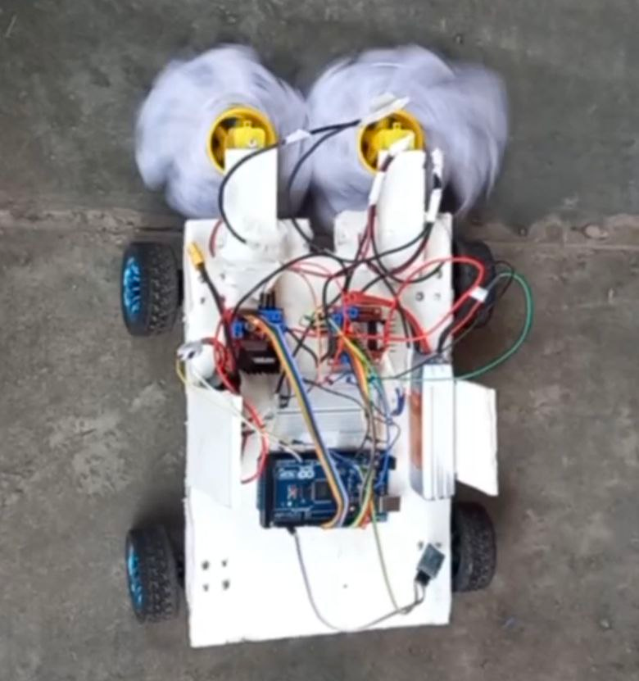
Overview
Objective
Block Diagram
Current Progress
Video Demonstration
Future Work

Slide 3


Objective
Development of an autonomous control floor cleaner
Optimization in order to make it cost-effective
Testing of its functionality in real-life situations

Slide 4


Block Diagram
Plant
(Motor &
Robot
Dynamics)
Input
(Sensor
Data)
+
Output
(Movement
& Cleaning)
Controller (Arduino)
-
Feedback
Control
(Gyro/
Sonar)

Slide 5
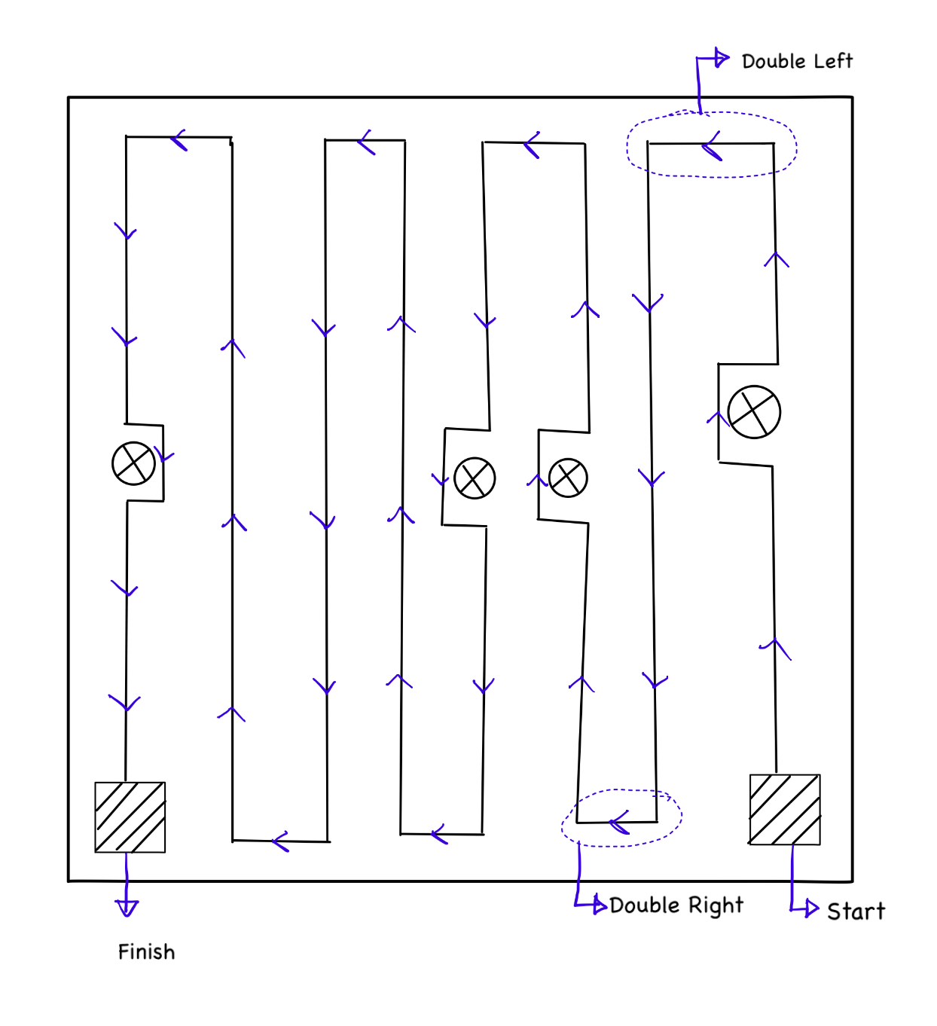
Navigation Map

Slide 6
Current Progress
Bot movement
The bot moves with manual instructions using Bluetooth module
Sonars have been used for detecting obstacles

Slide 7
Current Progress
Mopping
Mop rotates to clean a space
Pump sprays water for a fraction of time when the mopping process is active, then stays off, and the process repeats

Slide 8
Demonstration of bot and mopper movement

Slide 9
Future Work
As a part of future tasks, we’ll try to implement ---
Automatic Control of the bot and mop
Use of Gyro sensors to ensure balancing of the bot motion
More upgraded use of sonars to ensure the obstacle detection and change of movement direction more accurately

Slide 10
Thank You ! ^ ^

